Slide 1
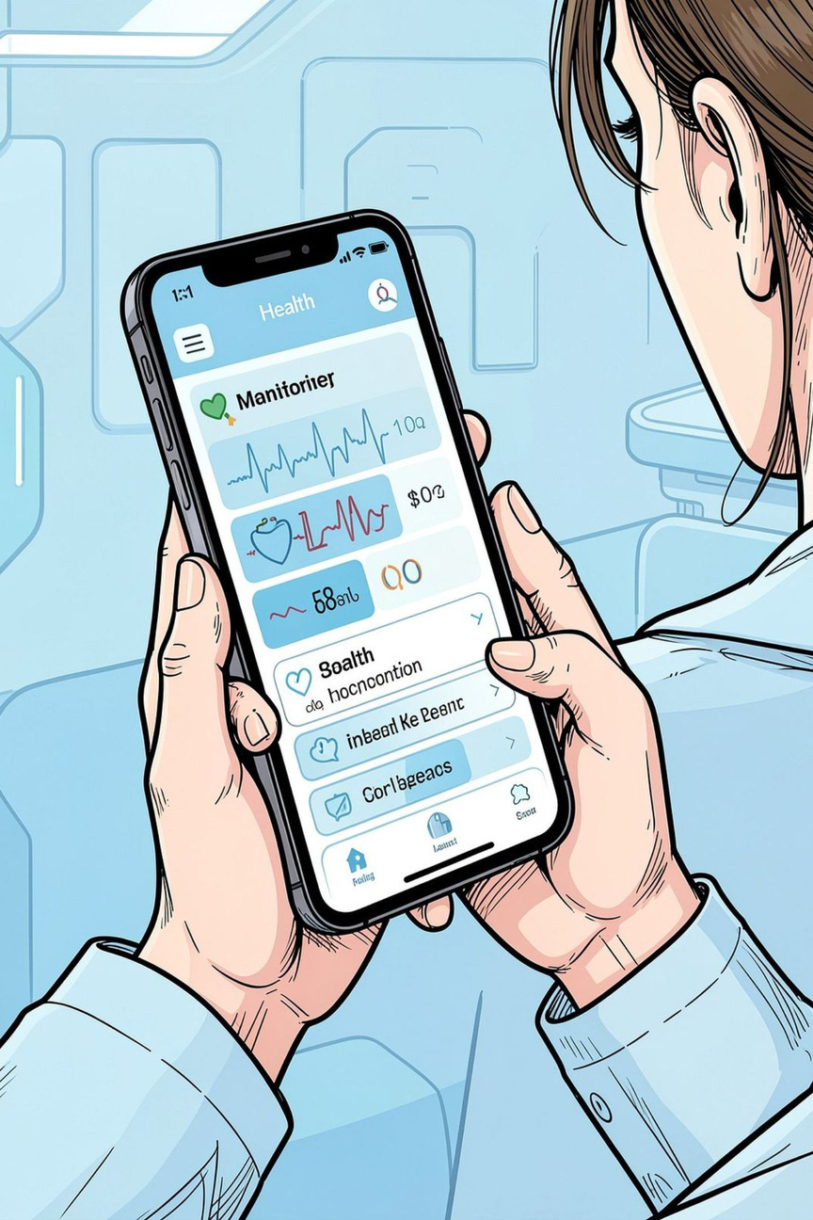

Hyperhidrosis Monitoring System
Aditya Rajput
Prabhkirat Kaur
Notes:
1.7.2013
1.7.2013
1.7.2013
1
‹#›
‹#›
‹#›

Slide 2

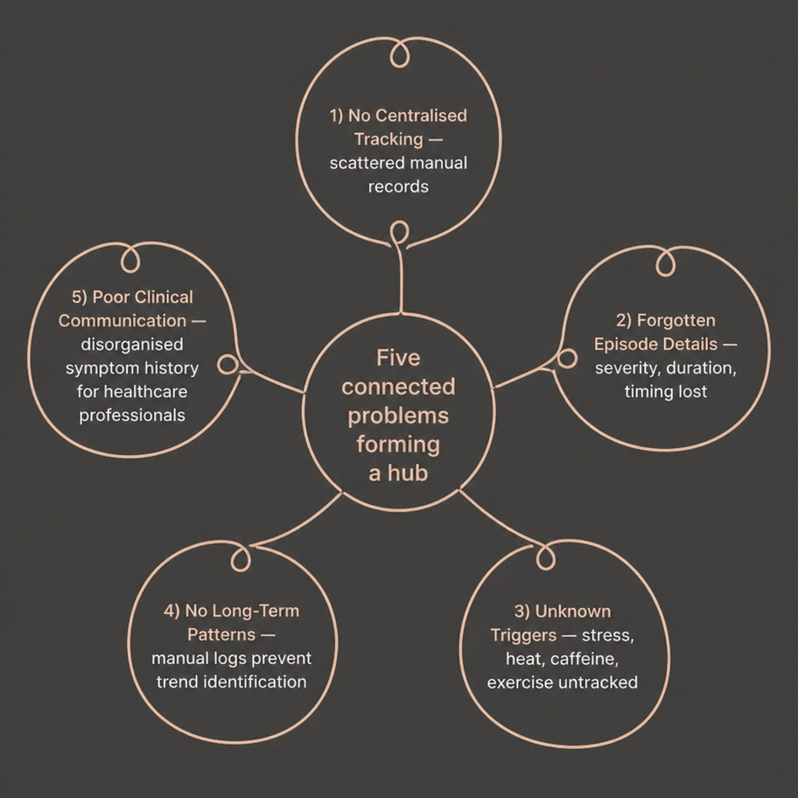
PROBLEM STATEMENT
Why Current Tracking Falls Short
    Hyperhidrosis is often difficult to track consistently without one central digital tool. Episodes, triggers, and severity quickly get lost across notes, memory, and messages.
    That makes it harder to spot patterns, understand what is affecting symptoms, and share a clear history with healthcare professionals.
Software Engineering Project | Hyperhidrosis Monitoring App
Notes:
1.7.2013
1.7.2013
1.7.2013
2
‹#›
‹#›
‹#›

Slide 3





MOTIVATION
Five Reasons This App Matters
Data-Driven Insights
Converts data into graph and statistics
Better Self-Monitoring
Helps to keep records of sweating
Pattern Identification
Identify patterns during stress or exercise
Technology for Healthcare
How SE is applied on Healthcare
Healthcare Communication
Generates organised professional reports
of user history
Software Engineering Project | Hyperhidrosis Monitoring App
Notes:
1.7.2013
1.7.2013
1.7.2013
3
‹#›
‹#›
‹#›

Slide 4
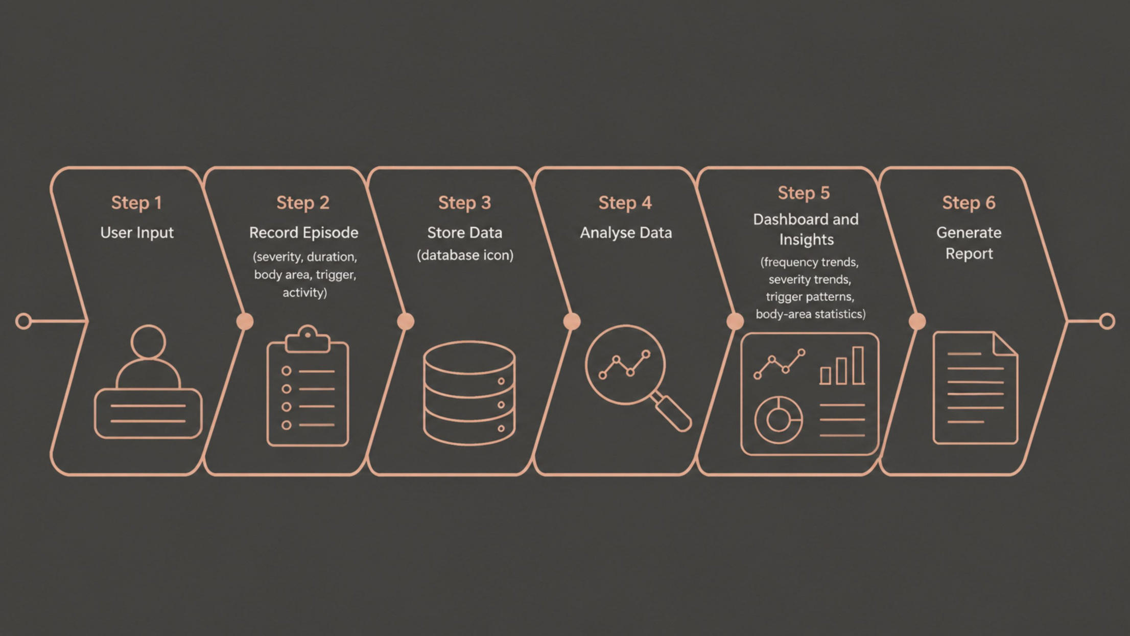
PROPOSED SOLUTION
System Architecture & Data Flow
Software Engineering Project | Hyperhidrosis Monitoring App
Notes:
1.7.2013
1.7.2013
1.7.2013
4
‹#›
‹#›
‹#›

Slide 5
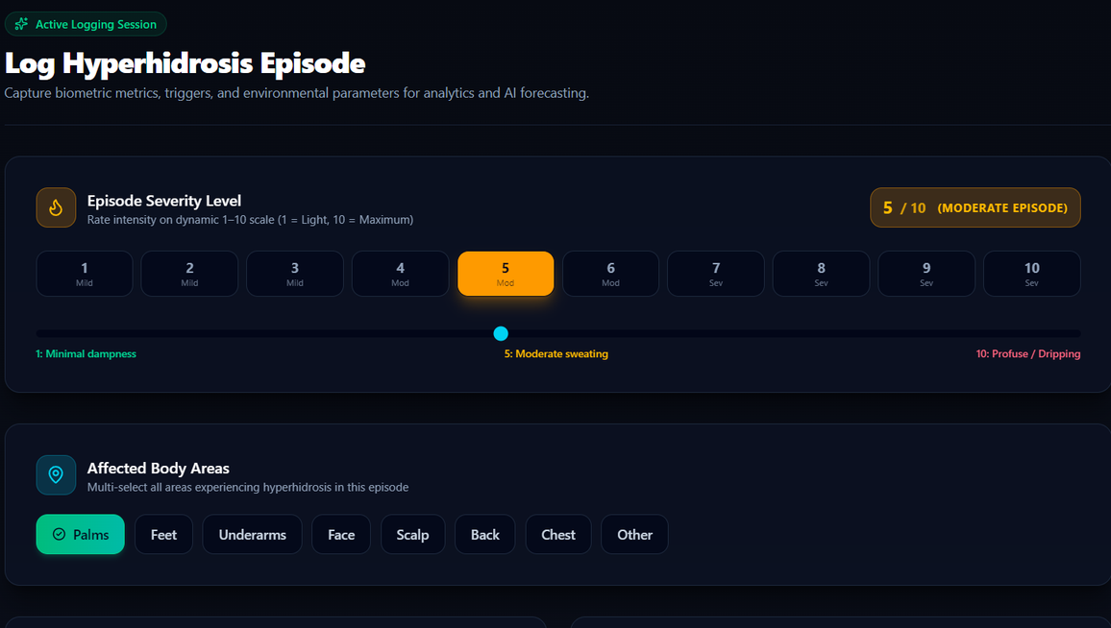
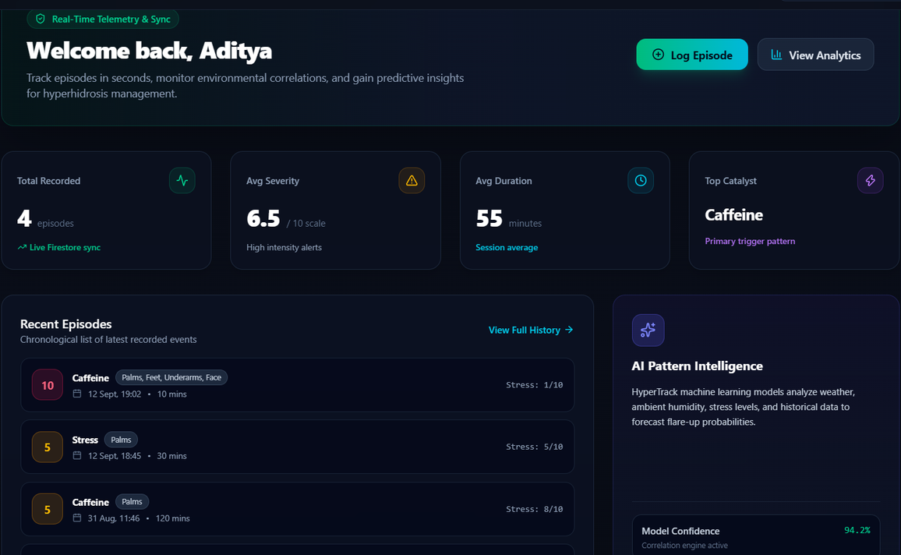
Output:

Slide 6
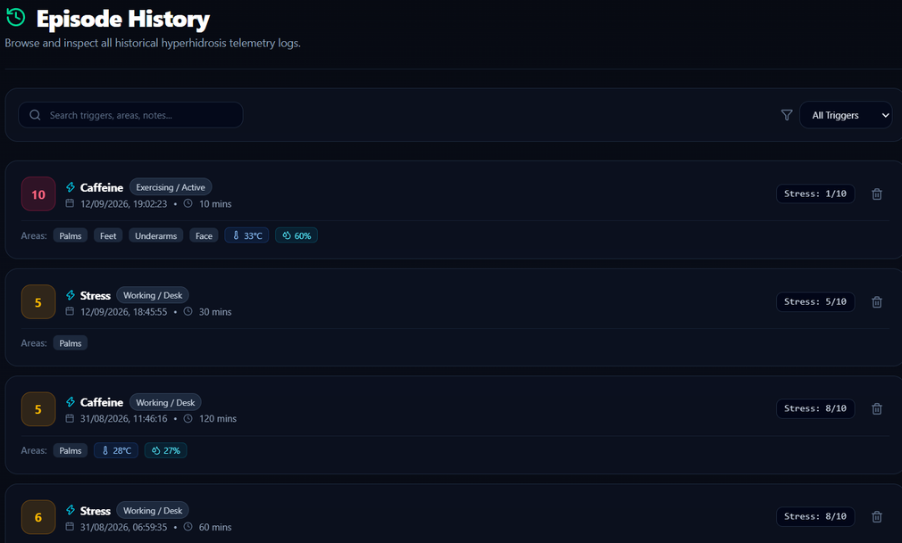
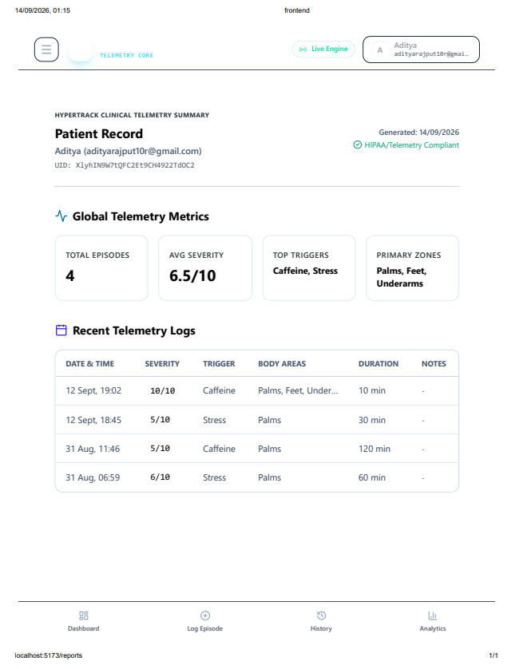
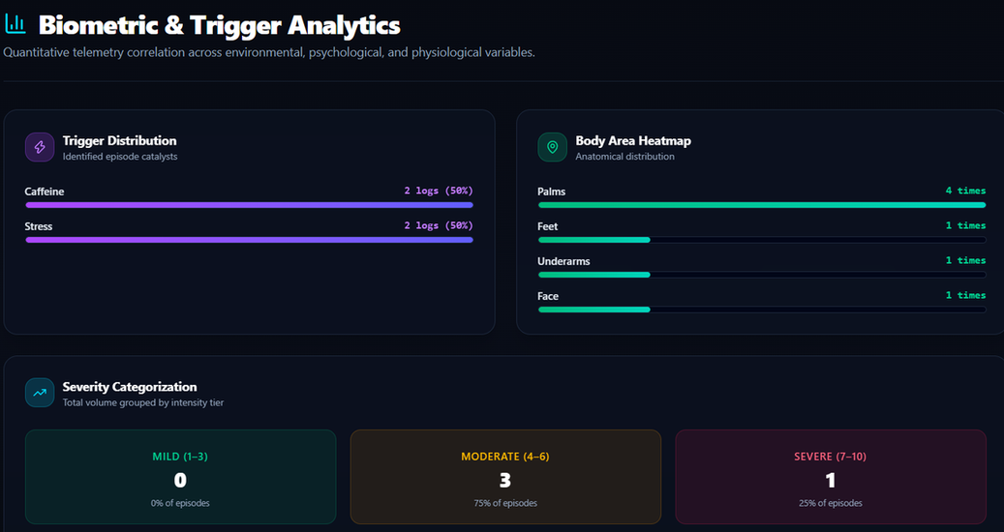

Slide 7
Thank You...

